Slide 1

Mathematical Models in
Pure and Applied Mathematics
Igor Andrianov
Notes:
Mathematical Models in Pure and Applied Mathematics:
Are They Completely the Same?
Andrianov I.V., RWTH Aachen University
A pure mathematician may say anything he pleases, but an applied mathematician must be at least partially sane.

Slide 2


Agenda
Simple example
Continualization
Kirchhoff’s nonlinear beam equation
Infinite systems and multiple limits
Poincaré’s and Lypunov’s traditions
Conclusions
A pure mathematician may say anything he pleases,
but an applied mathematician must be at least partially sane.
J. Williard Gibbs
Igor Andrianov
2

Slide 3
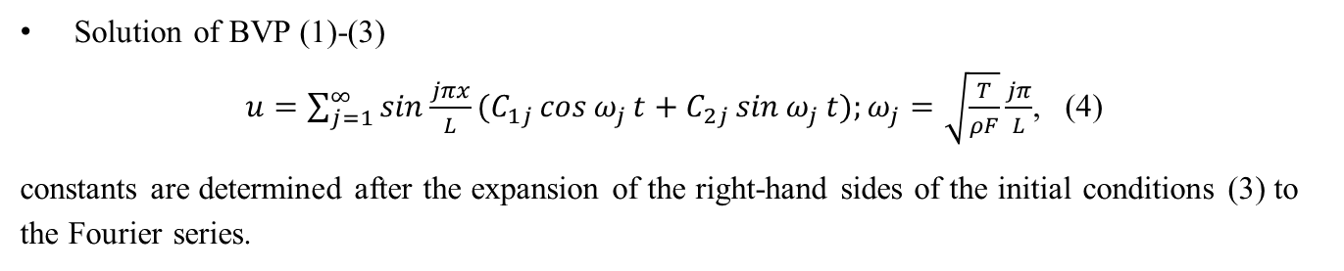
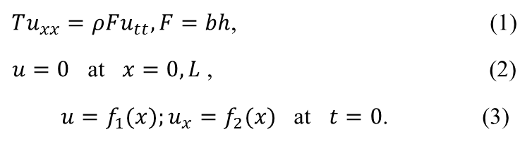
Simple Example: Beam, String and Small Divisors
Definition (axiomatic, math textbooks)
A string is called a flexible elastic thread that does not resist bending, but which provides resistance to stretching.
So, the bending rigidity EI = 0.
Mathematical model from pure math standpoint for string of rectangular cross-section b x h and length L
$Tu_{xx}=ρFu_{tt},F=bh$, (1)
$u=0$ at $x=0,L$ , (2)
$u=f_{1}(x);u_{x}=f_{2}(x)$ at $t=0$. (3)
Solution of BVP (1)-(3)
$u=\sum_{j=1}^{∞}{\sin{\frac{jπx}{L}}}(C_{1j}\cos{ω_{j}}t+C_{2j}\sin{ω_{j}}t);ω_{j}=\sqrt{\frac{T}{ρF}}\frac{jπ}{L}$, (4)
constants are determined after the expansion of the right-hand sides of the initial conditions (3) to the Fourier series.
Igor Andrianov
3
Notes:
Beam, string and small divisors
Definition (axiomatic, math textbooks). A string will be called a flexible elastic thread that does not resist bending, but which provides resistance to stretching. So, bending rigidity $EI=0.$ Mathematical model from pure math standpoint for string of rectangular cross-section b x h and length L is
$Tu_{xx}=ρFu_{tt},F=bh$ (1)
$u=0$ at $x=0,L$ (2)
$u=f_{1}(x);u_{x}=f_{2}(x)$ at $t=0$ (3)
Solution of BVP (1)-(3)
$u=\sum_{j=1}^{∞}{\sin{\frac{jπx}{L}}}(C_{1j}\cos{ω_{j}}t+C_{2j}\sin{ω_{j}}t);ω_{j}=\sqrt{\frac{T}{ρF}}\frac{jπ}{L}$, (4)
constants are determined after the expansion of the right-hand sides of the initial conditions (3) in a Fourier series.
Definition (asymptotic, physical or mechanical texbooks). The string will be called a thin, tightly stretched elastic thread, while the tension is so great, the bending resistance can be neglected $ε^{2}=\frac{EI}{TL^{2}}<<1$.
The equation of string vibrations taking into account the bending stiffness can be written as
$−EIu_{xxxx}+Tu_{xx}=ρFu_{tt},I=bh^{3}/12$ (5)
Without loss of generality, we accept the stretched beam is symply supported
$u=u_{xx}=0$ at $x=0,L$ (6)
If the solution is searched in the form of series, a new parameter appears, which must be compared with parameter $ε^{−1}=\sqrt{\frac{TL^{2}}{EI}}$. For $j<<ε^{−1}$ string model can (1) be used, then
$u≈\sum_{j=1}^{N}{\sin{\frac{jπx}{L}}}(C_{1j}\cos{ω_{j}}t+C_{2j}\sin{ω_{j}}t),N≈ε^{−1}$ (7)
For $j>>ε^{−1}$ one can use beam model
$−EIu_{xxxx}=ρFu_{tt}$ (8)
For $j∼\frac{1}{\max{(}h/L;b/L)}$ one can use 3D elasticity model, etc.
String with variables parameters - infinite system of ODE?
String on the nonlinear foundations
$Tu_{xx}+cu^{3}=ρFu_{tt},\frac{cF^{2}L^{2}}{T}<<1$ (9)
Standard perturbation approach leads to small divisors problem.
To overcome this difficulty, a generalization of KAM theory and other complicated methods are used. But this is the problem of pure math. This is the problem for PDE (9), but not for original physical problem – oscillation of stretched beam with small bending stiffens on elastic foundation.
The problem of small divisors is physically manifested in combination resonances. There is a significant difference between the tasks of celestial mechanics, with which the KAM theory deals, and the problem of the mathematical physics which usually subdivided into a few subproblems.
For comparing of model of pure and applied math let us introduce index of function variation$λ$
$u_{x}∼ε^{λ}u$ (10)
Pure math model of string: PDE of hyperbolic type
$Tu_{xx}=ρFu_{tt}$ (11)
Applied math model: PDE (11) and restriction
$λ≥−1$ (12)

Slide 4
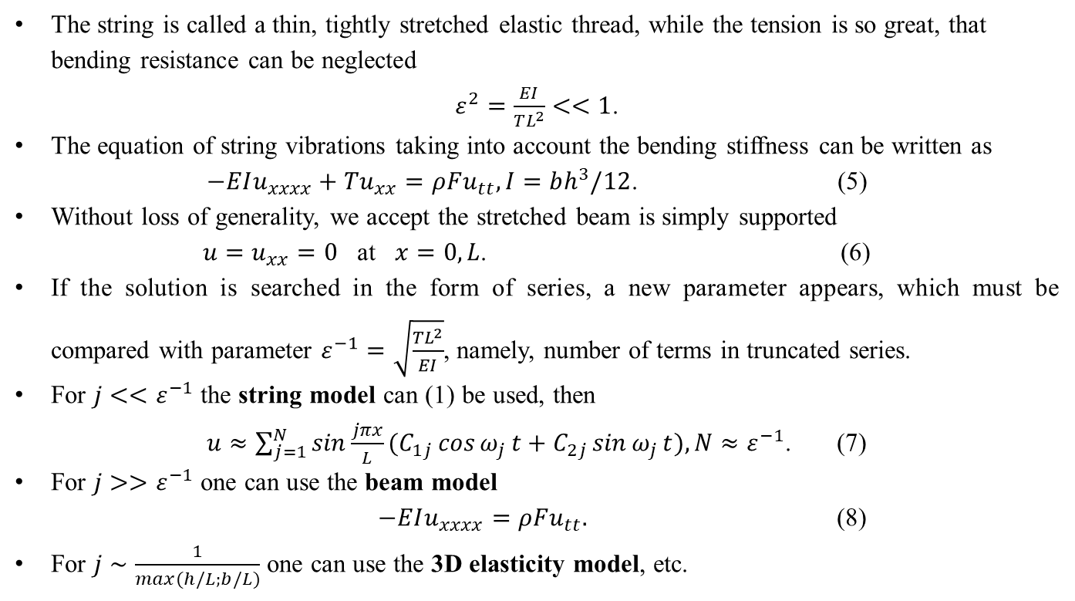
Simple Example (2)
Definition (asymptotic, physical or mechanical textbooks)
The string is called a thin, tightly stretched elastic thread, while the tension is so great, that bending resistance can be neglected
$ε^{2}=\frac{EI}{TL^{2}}<<1$.
The equation of string vibrations taking into account the bending stiffness can be written as
$−EIu_{xxxx}+Tu_{xx}=ρFu_{tt},I=bh^{3}/12$. (5)
Without loss of generality, we accept the stretched beam is simply supported
$u=u_{xx}=0$ at $x=0,L$. (6)
If the solution is searched in the form of series, a new parameter appears, which must be compared with parameter $ε^{−1}=\sqrt{\frac{TL^{2}}{EI}}$, namely, number of terms in truncated series.
For $j<<ε^{−1}$ the string model can (1) be used, then
$u≈\sum_{j=1}^{N}{\sin{\frac{jπx}{L}}}(C_{1j}\cos{ω_{j}}t+C_{2j}\sin{ω_{j}}t),N≈ε^{−1}$. (7)
For $j>>ε^{−1}$ one can use the beam model
$−EIu_{xxxx}=ρFu_{tt}.$ (8)
For $j∼\frac{1}{\max{(}h/L;b/L)}$ one can use the 3D elasticity model, etc.
Igor Andrianov
4
Notes:
Beam, string and small divisors
Definition (axiomatic, math textbooks). A string will be called a flexible elastic thread that does not resist bending, but which provides resistance to stretching. So, bending rigidity $EI=0.$ Mathematical model from pure math standpoint for string of rectangular cross-section b x h and length L is
$Tu_{xx}=ρFu_{tt},F=bh$ (1)
$u=0$ at $x=0,L$ (2)
$u=f_{1}(x);u_{x}=f_{2}(x)$ at $t=0$ (3)
Solution of BVP (1)-(3)
$u=\sum_{j=1}^{∞}{\sin{\frac{jπx}{L}}}(C_{1j}\cos{ω_{j}}t+C_{2j}\sin{ω_{j}}t);ω_{j}=\sqrt{\frac{T}{ρF}}\frac{jπ}{L}$, (4)
constants are determined after the expansion of the right-hand sides of the initial conditions (3) in a Fourier series.
Definition (asymptotic, physical or mechanical texbooks). The string will be called a thin, tightly stretched elastic thread, while the tension is so great, the bending resistance can be neglected $ε^{2}=\frac{EI}{TL^{2}}<<1$.
The equation of string vibrations taking into account the bending stiffness can be written as
$−EIu_{xxxx}+Tu_{xx}=ρFu_{tt},I=bh^{3}/12$ (5)
Without loss of generality, we accept the stretched beam is symply supported
$u=u_{xx}=0$ at $x=0,L$ (6)
If the solution is searched in the form of series, a new parameter appears, which must be compared with parameter $ε^{−1}=\sqrt{\frac{TL^{2}}{EI}}$. For $j<<ε^{−1}$ string model can (1) be used, then
$u≈\sum_{j=1}^{N}{\sin{\frac{jπx}{L}}}(C_{1j}\cos{ω_{j}}t+C_{2j}\sin{ω_{j}}t),N≈ε^{−1}$ (7)
For $j>>ε^{−1}$ one can use beam model
$−EIu_{xxxx}=ρFu_{tt}$ (8)
For $j∼\frac{1}{\max{(}h/L;b/L)}$ one can use 3D elasticity model, etc.
String with variables parameters - infinite system of ODE?
String on the nonlinear foundations
$Tu_{xx}+cu^{3}=ρFu_{tt},\frac{cF^{2}L^{2}}{T}<<1$ (9)
Standard perturbation approach leads to small divisors problem.
To overcome this difficulty, a generalization of KAM theory and other complicated methods are used. But this is the problem of pure math. This is the problem for PDE (9), but not for original physical problem – oscillation of stretched beam with small bending stiffens on elastic foundation.
The problem of small divisors is physically manifested in combination resonances. There is a significant difference between the tasks of celestial mechanics, with which the KAM theory deals, and the problem of the mathematical physics which usually subdivided into a few subproblems.
For comparing of model of pure and applied math let us introduce index of function variation$λ$
$u_{x}∼ε^{λ}u$ (10)
Pure math model of string: PDE of hyperbolic type
$Tu_{xx}=ρFu_{tt}$ (11)
Applied math model: PDE (11) and restriction
$λ≥−1$ (12)

Slide 5
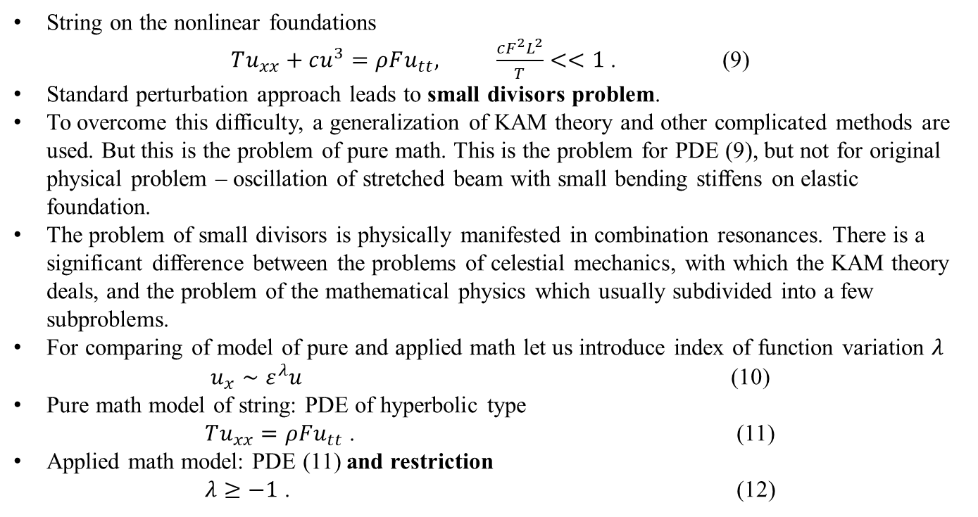
Simple Example (3)
String on the nonlinear foundations
$Tu_{xx}+cu^{3}=ρFu_{tt}, \frac{cF^{2}L^{2}}{T}<<1$ . (9)
Standard perturbation approach leads to small divisors problem.
To overcome this difficulty, a generalization of KAM theory and other complicated methods are used. But this is the problem of pure math. This is the problem for PDE (9), but not for original physical problem – oscillation of stretched beam with small bending stiffens on elastic foundation.
The problem of small divisors is physically manifested in combination resonances. There is a significant difference between the problems of celestial mechanics, with which the KAM theory deals, and the problem of the mathematical physics which usually subdivided into a few subproblems.
For comparing of model of pure and applied math let us introduce index of function variation $λ$
$u_{x}∼ε^{λ}u$ (10)
Pure math model of string: PDE of hyperbolic type
$Tu_{xx}=ρFu_{tt}$ . (11)
Applied math model: PDE (11) and restriction
$λ≥−1$ . (12)
Igor Andrianov
5
Notes:
Beam, string and small divisors
Definition (axiomatic, math textbooks). A string will be called a flexible elastic thread that does not resist bending, but which provides resistance to stretching. So, bending rigidity $EI=0.$ Mathematical model from pure math standpoint for string of rectangular cross-section b x h and length L is
$Tu_{xx}=ρFu_{tt},F=bh$ (1)
$u=0$ at $x=0,L$ (2)
$u=f_{1}(x);u_{x}=f_{2}(x)$ at $t=0$ (3)
Solution of BVP (1)-(3)
$u=\sum_{j=1}^{∞}{\sin{\frac{jπx}{L}}}(C_{1j}\cos{ω_{j}}t+C_{2j}\sin{ω_{j}}t);ω_{j}=\sqrt{\frac{T}{ρF}}\frac{jπ}{L}$, (4)
constants are determined after the expansion of the right-hand sides of the initial conditions (3) in a Fourier series.
Definition (asymptotic, physical or mechanical texbooks). The string will be called a thin, tightly stretched elastic thread, while the tension is so great, the bending resistance can be neglected $ε^{2}=\frac{EI}{TL^{2}}<<1$.
The equation of string vibrations taking into account the bending stiffness can be written as
$−EIu_{xxxx}+Tu_{xx}=ρFu_{tt},I=bh^{3}/12$ (5)
Without loss of generality, we accept the stretched beam is symply supported
$u=u_{xx}=0$ at $x=0,L$ (6)
If the solution is searched in the form of series, a new parameter appears, which must be compared with parameter $ε^{−1}=\sqrt{\frac{TL^{2}}{EI}}$. For $j<<ε^{−1}$ string model can (1) be used, then
$u≈\sum_{j=1}^{N}{\sin{\frac{jπx}{L}}}(C_{1j}\cos{ω_{j}}t+C_{2j}\sin{ω_{j}}t),N≈ε^{−1}$ (7)
For $j>>ε^{−1}$ one can use beam model
$−EIu_{xxxx}=ρFu_{tt}$ (8)
For $j∼\frac{1}{\max{(}h/L;b/L)}$ one can use 3D elasticity model, etc.
String with variables parameters - infinite system of ODE?
String on the nonlinear foundations
$Tu_{xx}+cu^{3}=ρFu_{tt},\frac{cF^{2}L^{2}}{T}<<1$ (9)
Standard perturbation approach leads to small divisors problem.
To overcome this difficulty, a generalization of KAM theory and other complicated methods are used. But this is the problem of pure math. This is the problem for PDE (9), but not for original physical problem – oscillation of stretched beam with small bending stiffens on elastic foundation.
The problem of small divisors is physically manifested in combination resonances. There is a significant difference between the tasks of celestial mechanics, with which the KAM theory deals, and the problem of the mathematical physics which usually subdivided into a few subproblems.
For comparing of model of pure and applied math let us introduce index of function variation$λ$
$u_{x}∼ε^{λ}u$ (10)
Pure math model of string: PDE of hyperbolic type
$Tu_{xx}=ρFu_{tt}$ (11)
Applied math model: PDE (11) and restriction
$λ≥−1$ (12)

Slide 6
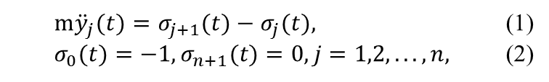
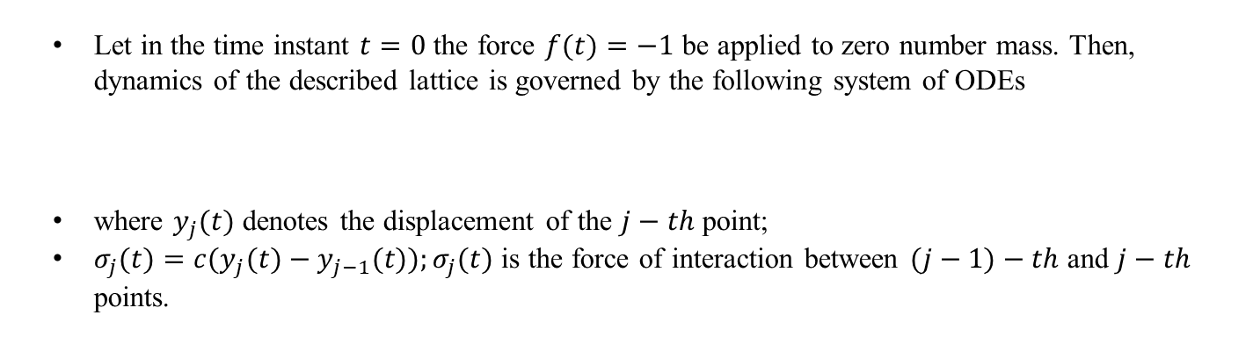



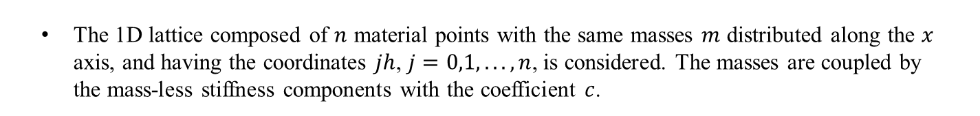

Classical Continualization and Splash Effect
The 1D lattice composed of $n$ material points with the same masses $m$ distributed along the $x$ axis, and having the coordinates $jh$, $j=0,1,...,n$, is considered. The masses are coupled by the mass-less stiffness components with the coefficient $c$.
$$c$$
$$c$$
$$c$$
$$m$$
$$m$$
$$m$$
$$m$$
Fig. 1. n-mass oscillator (model for railway carriage)
Let in the time instant $t=0$ the force $f(t)=−1$ be applied to zero number mass. Then, dynamics of the described lattice is governed by the following system of ODEs
where $y_{j}(t)$ denotes the displacement of the $j−th$ point;
$σ_{j}(t)=c(y_{j}(t)−y_{j−1}(t));σ_{j}(t)$ is the force of interaction between $(j−1)−th$ and $j−th$ points.
$m{\ddot{y}}_{j}(t)=σ_{j+1}(t)−σ_{j}(t),$ (1)
$σ_{0}(t)=−1,σ_{n+1}(t)=0,j=1,2,...,n,$ (2)
Igor Andrianov
6

Slide 7
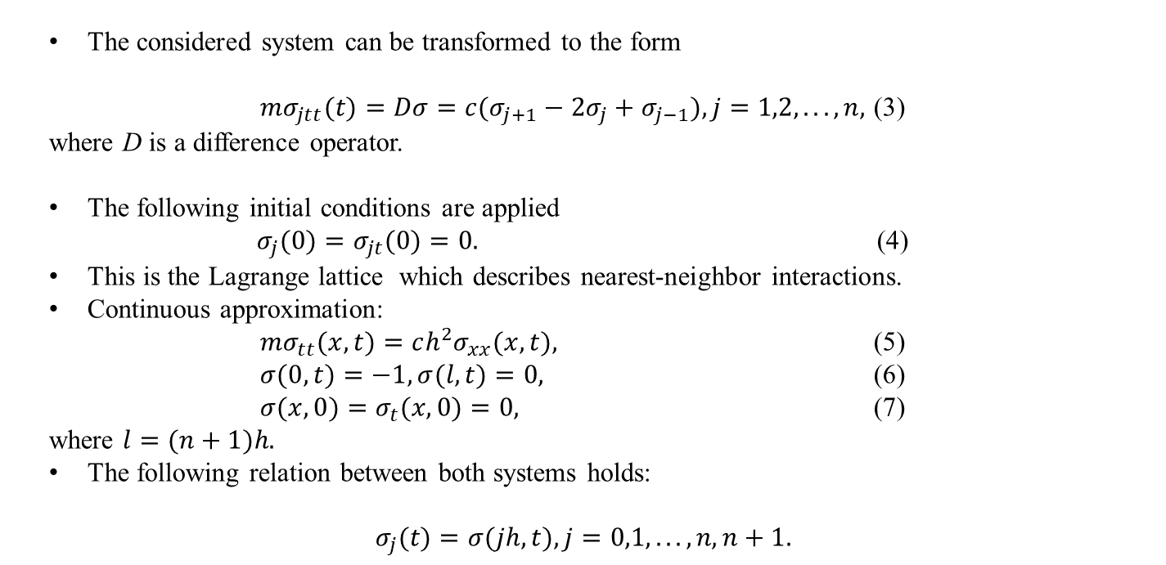
Classical Continualization (2)
The considered system can be transformed to the form
$mσ_{jtt}(t)=Dσ=c(σ_{j+1}−2σ_{j}+σ_{j−1}),j=1,2,...,n,$ (3)
where D is a difference operator.
The following initial conditions are applied
$σ_{j}(0)=σ_{jt}(0)=0.$ (4)
This is the Lagrange lattice which describes nearest-neighbor interactions.
Continuous approximation:
$mσ_{tt}(x,t)=ch^{2}σ_{xx}(x,t),$ (5)
$σ(0,t)=−1,σ(l,t)=0,$ (6)
$σ(x,0)=σ_{t}(x,0)=0,$ (7)
where $l=(n+1)h.$
The following relation between both systems holds:
$$σ_{j}(t)=σ(jh,t),j=0,1,...,n,n+1.$$
Igor Andrianov
7

Slide 8
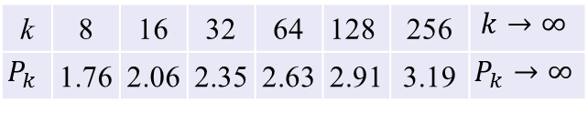
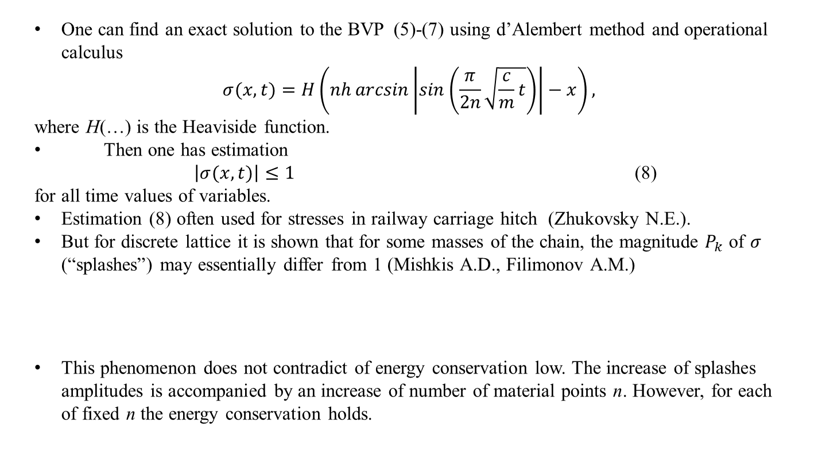
Classical Continualization (3)
One can find an exact solution to the BVP (5)-(7) using d’Alembert method and operational calculus
$$σ(x,t)=H\left(nh\arcsin\left|\sin\left(\frac{π}{2n}\sqrt{\frac{c}{m}t}\right)\right|−x\right),$$
where H(…) is the Heaviside function.
Then one has estimation
$\left|σ(x,t)\right|≤1$ (8)
for all time values of variables.
Estimation (8) often used for stresses in railway carriage hitch (Zhukovsky N.E.).
But for discrete lattice it is shown that for some masses of the chain, the magnitude $P_{k}$ of $σ$ (“splashes”) may essentially differ from 1 (Mishkis A.D., Filimonov A.M.)
This phenomenon does not contradict of energy conservation low. The increase of splashes amplitudes is accompanied by an increase of number of material points n. However, for each of fixed n the energy conservation holds.
k | 8 | 16 | 32 | 64 | 128 | 256 | $$k→∞$$
$$P_{k}$$ | 1.76 | 2.06 | 2.35 | 2.63 | 2.91 | 3.19 | $$P_{k}→∞$$
Igor Andrianov
8

Slide 9

Classical Continualization (4)
For continuous system one has
$σ=1−\frac{x}{l}−\frac{2l}{π}\sum_{k=1}^{n}{\frac{\sin{\frac{kπx}{l}}}{k}\cos\left(α_{k}t\right)}$. (9)
Exact solution of discrete system
$σ_{j}=1−\frac{jl}{n+1}−\frac{l}{n+1}\sum_{k=1}^{n}{\sin{\frac{πkj}{n+1}}ctg}\frac{πk}{2\left(n+1\right)}\cos{(}ω_{k}t),j=0,1,…,n.$ (10)
Coefficients
$\frac{l}{n+1}ctg\frac{πk}{2\left(n+1\right)}$ and $\frac{2l}{πk}$
are close to each other only for $k<<n+1.$
Igor Andrianov
9

Slide 10
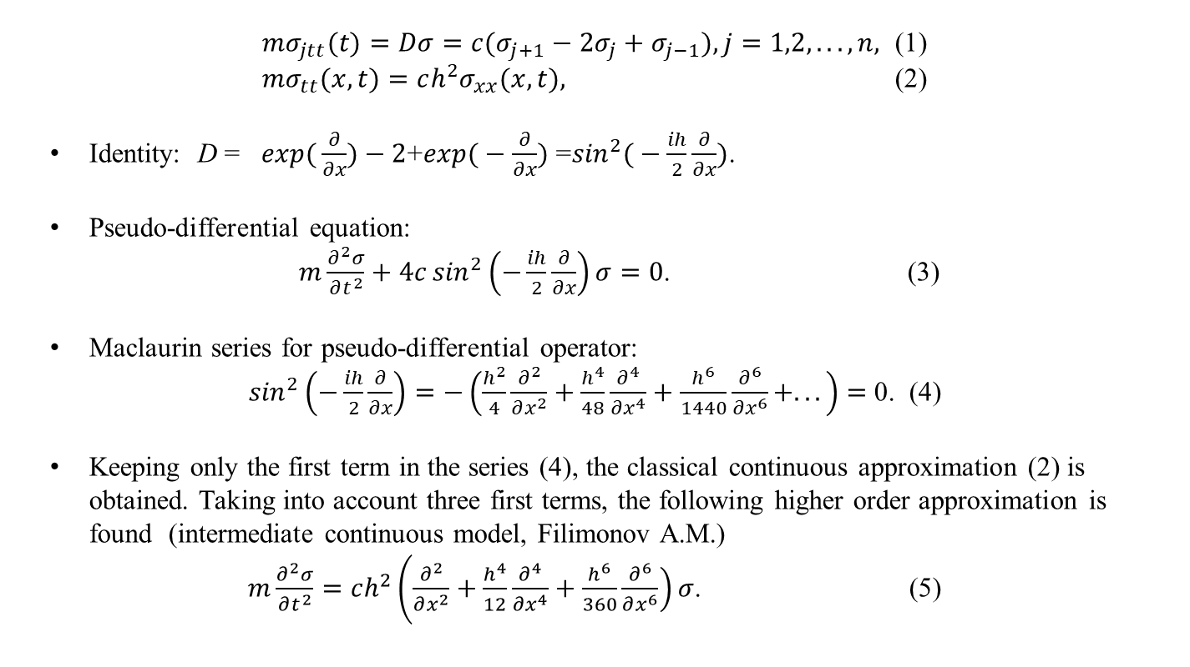
Intermediate Continuous Models
$mσ_{jtt}(t)=Dσ=c(σ_{j+1}−2σ_{j}+σ_{j−1}),j=1,2,...,n,$ (1)
$mσ_{tt}(x,t)=ch^{2}σ_{xx}(x,t),$ (2)
Identity: D = $\exp{(}\frac{∂}{∂x})−2$+$\exp{(}−\frac{∂}{∂x})$ =$\sin^{2}{(}−\frac{ih}{2}\frac{∂}{∂x})$.
Pseudo-differential equation:
$m\frac{∂^{2}σ}{∂t^{2}}+4c\sin^{2}\left(−\frac{ih}{2}\frac{∂}{∂x}\right)σ=0$. (3)
Maclaurin series for pseudo-differential operator:
$\sin^{2}\left(−\frac{ih}{2}\frac{∂}{∂x}\right)=−\left(\frac{h^{2}}{4}\frac{∂^{2}}{∂x^{2}}+\frac{h^{4}}{48}\frac{∂^{4}}{∂x^{4}}+\frac{h^{6}}{1440}\frac{∂^{6}}{∂x^{6}}+...\right)=$ 0. (4)
Keeping only the first term in the series (4), the classical continuous approximation (2) is obtained. Taking into account three first terms, the following higher order approximation is found (intermediate continuous model, Filimonov A.M.)
$m\frac{∂^{2}σ}{∂t^{2}}=ch^{2}\left(\frac{∂^{2}}{∂x^{2}}+\frac{h^{4}}{12}\right.\frac{∂^{4}}{∂x^{4}}+\left.\frac{h^{6}}{360}\frac{∂^{6}}{∂x^{6}}\right)σ$. (5)
Igor Andrianov
10

Slide 11
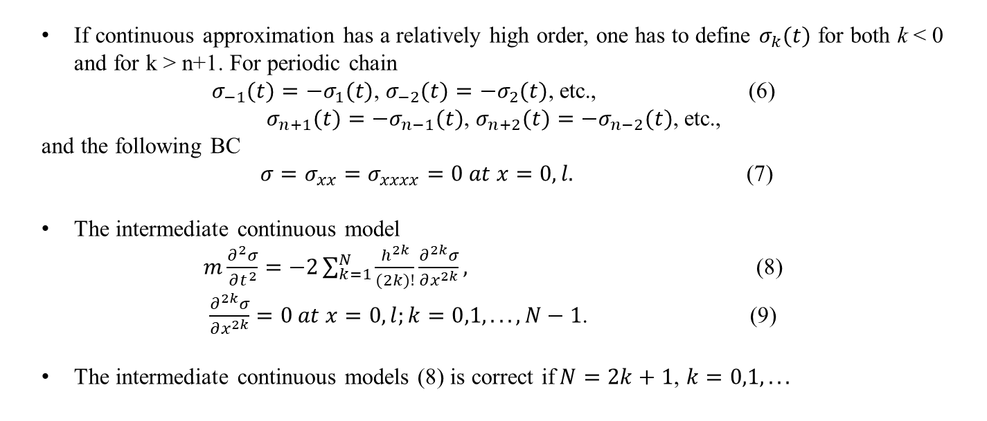
Intermediate Continuous Models (2)
If continuous approximation has a relatively high order, one has to define $σ_{k}(t)$ for both k < 0 and for k > n+1. For periodic chain
$σ_{−1}(t)=−σ_{1}(t)$, $σ_{−2}(t)=−σ_{2}(t)$, etc., (6)
$σ_{n+1}(t)=−σ_{n−1}(t)$, $σ_{n+2}(t)=−σ_{n−2}(t)$, etc.,
and the following BC
$σ=σ_{xx}=σ_{xxxx}=0 at x=0,l.$ (7)
The intermediate continuous model
$m\frac{∂^{2}σ}{∂t^{2}}=−2\sum_{k=1}^{N}{\frac{h^{2k}}{(2k)!}}\frac{∂^{2k}σ}{∂x^{2k}},$ (8)
$\frac{∂^{2k}σ}{∂x^{2k}}=0 at x=0,l;k=0,1,...,N−1$. (9)
The intermediate continuous models (8) is correct if$N=2k+1$, $k=0,1,...$
Igor Andrianov
11

Slide 12


Flowering Meadow or Minefield?
Way of Pure Mathematician
Way of Applied Mathematician (between Scylla and Charybdis)
Igor Andrianov
12

Slide 13
Holmes Paper
Igor Andrianov
13

Slide 14
Holmes Paper (2)
Igor Andrianov
14

Slide 15
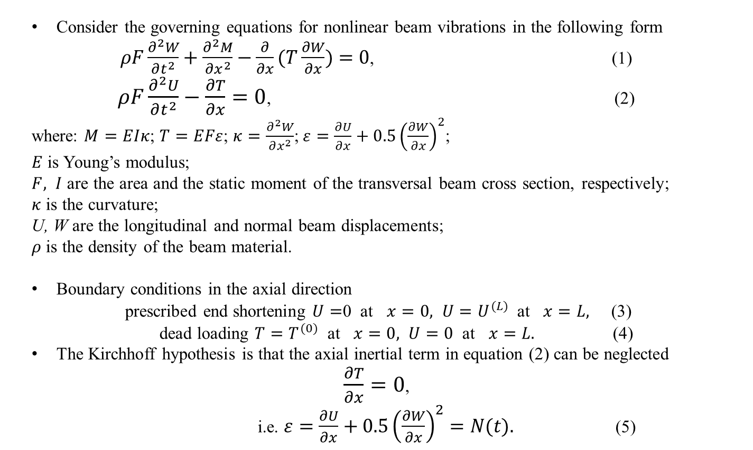
Kirchhoff’s Nonlinear Beam Model
Consider the governing equations for nonlinear beam vibrations in the following form
$ρF\frac{∂^{2}W}{∂t^{2}}+\frac{∂^{2}M}{∂x^{2}}−\frac{∂}{∂x}(T\frac{∂W}{∂x})=0$, (1)
$ρF\frac{∂^{2}U}{∂t^{2}}−\frac{∂T}{∂x}=0$, (2)
where: $M=EIκ$; $T=EFε$; $κ=\frac{∂^{2}W}{∂x^{2}}$;$ε=\frac{∂U}{∂x}+0.5{\left(\frac{∂W}{∂x}\right)}^{2}$;
$E$ is Young’s modulus;
$F, I$ are the area and the static moment of the transversal beam cross section, respectively;
$κ$ is the curvature;
U, W are the longitudinal and normal beam displacements;
$ρ$ is the density of the beam material.
Boundary conditions in the axial direction
prescribed end shortening $U=$0 at $x=0, U=U^{(L)}$ at $x=L,$ (3)
dead loading $T=T^{(0)}$ at $x=0, U=0$ at $x=L.$ (4)
The Kirchhoff hypothesis is that the axial inertial term in equation (2) can be neglected
$\frac{∂T}{∂x}=0$,
i.e. $ε=\frac{∂U}{∂x}+0.5{\left(\frac{∂W}{∂x}\right)}^{2}=N(t).$ (5)
Igor Andrianov
15

Slide 16
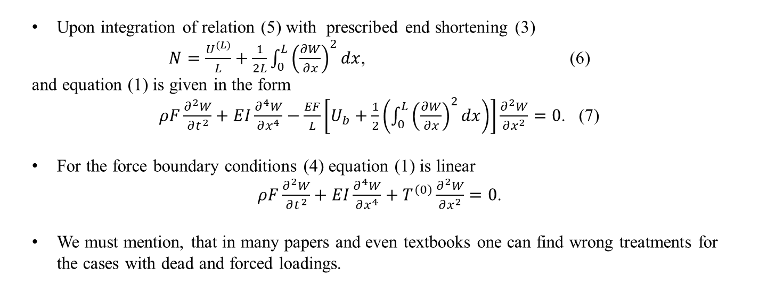
Kirchhoff’s Nonlinear Beam Model (2)
Upon integration of relation (5) with prescribed end shortening (3)
$N=\frac{U^{(L)}}{L}+\frac{1}{2L}\int_{0}^{L}{{\left(\frac{∂W}{∂x}\right)}^{2}}dx$, (6)
and equation (1) is given in the form
$ρF\frac{∂^{2}W}{∂t^{2}}+EI\frac{∂^{4}W}{∂x^{4}}−\frac{EF}{L}\left[U_{b}+\frac{1}{2}\left(\int_{0}^{L}{{\left(\frac{∂W}{∂x}\right)}^{2}dx}\right)\right]\frac{∂^{2}W}{∂x^{2}}=0$. (7)
For the force boundary conditions (4) equation (1) is linear
$ρF\frac{∂^{2}W}{∂t^{2}}+EI\frac{∂^{4}W}{∂x^{4}}+T^{(0)}\frac{∂^{2}W}{∂x^{2}}=0$.
We must mention, that in many papers and even textbooks one can find wrong treatments for the cases with dead and forced loadings.
Igor Andrianov
16

Slide 17
Infinite Systems and Multiple Limits
Multiple limit processes
Nontruncated systems of ODE and regularization
In applied problems we often must deal with multiple limit process, in which two or more perturbation quantities approach their limits simultaneously.
Even more, we can treat this situation as common case. The order of passing to the limits cannot, in general, be changed.
In many papers showed that as a rule, mathematically incorrect to truncate the infinite mode representation for the oscillations to a single or a few modes of oscillations (Wim van Horssen). For a resonant problem the truncation can lead in certain cases to results which describe wrong internal mode-interactions.
Igor Andrianov
17

Slide 18
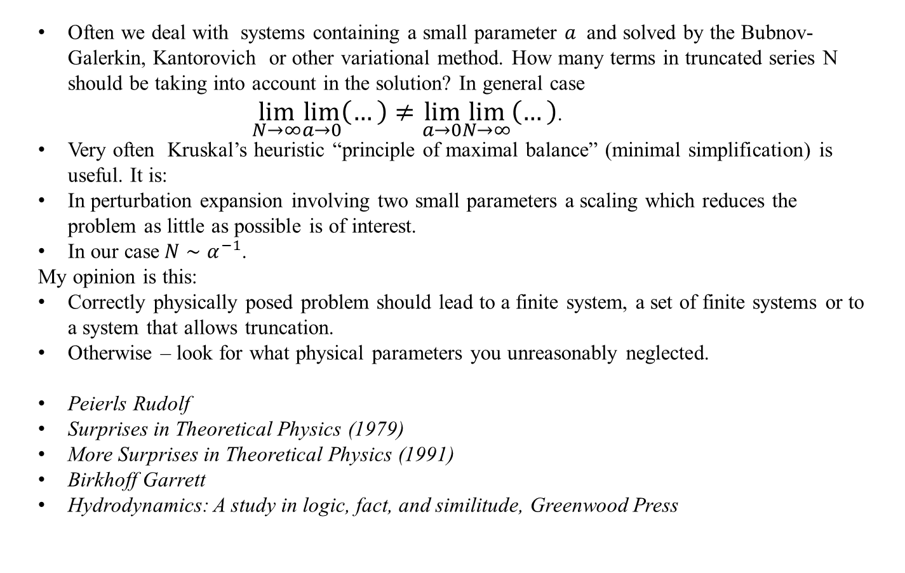
Infinite Systems and Multiple Limits (2)
Often we deal with systems containing a small parameter $a$ and solved by the Bubnov-Galerkin, Kantorovich or other variational method. How many terms in truncated series N should be taking into account in the solution? In general case
$\lim_{N→∞}\lim_{a→0}\left(…\right)≠\lim_{a→0}\lim_{N→∞}\left(…\right)$.
Very often Kruskal’s heuristic “principle of maximal balance” (minimal simplification) is useful. It is:
In perturbation expansion involving two small parameters a scaling which reduces the problem as little as possible is of interest.
In our case$N∼α^{−1}$.
My opinion is this:
Correctly physically posed problem should lead to a finite system, a set of finite systems or to a system that allows truncation.
Otherwise – look for what physical parameters you unreasonably neglected.
Peierls Rudolf
Surprises in Theoretical Physics (1979)
More Surprises in Theoretical Physics (1991)
Birkhoff Garrett
Hydrodynamics: A study in logic, fact, and similitude, Greenwood Press
Igor Andrianov
18

Slide 19
Poincaré’s and Lyapunov’s Traditions
It is interesting to recall a discussion between Poincaré and Lyapunov regarding figures of equilibrium for rotating, gravitating liquids.
Poincaré, who obtained his results using not so rigorous reasoning and often by simple analogy, wrote, “It is possible to make many objections, but the same rigor as in pure analysis is not demanded in mechanics”.
Lyapunov had entirely different position: “It is impermissible to use doubtful reasonings when solving a problem in mechanics or physics (it is the same) if it is formulated quite definitely as a mathematical one. In that case, it becomes a problem of pure analysis and must be treated as such”.
“Mathematics may be compared to a mill of exquisite workmanship, which grinds you stuff of any degree of fineness; but, nevertheless, what you get out depends upon what you put in; and as the grandest mill in the world will not extract wheat-flour from peascod, so pages of formulae will not get a definite result out of loose data” Huxley T.H.
So, we must try to put a good grain in our mathematical mills and avoid GIGO (Garbage In–Garbage Out).
Igor Andrianov
19

Slide 20
Conclusions
Applied math is not
  Pure math
  Physics
  Engineering
In fact it is Asymptotic math.
6th Hilbert problem
Truesdell -Noll axiomatization of continuous mechanics
Zruravlev axiomatization of classical mechanics
Math rigor – reality or fake statement?
Pythagoras and Fermat theorems; KAM theorem
Univalent foundations were devised by Vladimir Voevodsky (Fields medal winner) with the goal of enabling those who work in classical pure mathematics to use computers to verify their theorems and constructions.
Galileo: in the Saggiatore (1623) there is a famous quotation:
  La filosofia e scritta in questo grandissimo libro che continuamente ci sta aperto innanzi a gli occhi (io dico l'universo) . . . Egli e scritto in lingua matematica.
  Philosophy is written in this very great book that is there constantly open to our eyes (I mean the universe) . . . It is written in mathematical language.
Maybe, this great book is written in asymptotic language?
Igor Andrianov
20

Slide 21
Conclusions (2)
Pure Math is not more accurate than Applied Math – they deal with different objects:
  Pure Math – with axiomatically defined, Applied Math – asymptotically defined.
  Pure Math objects are clearly defined, Applied Math objects are fuzzy ones.
2. Lyapunov‘s tradition and Poincaré‘s tradition.
3. Accounting new effects in the model: before taking a step forward, take a step back.
4.Combining perturbation methods with variational or numerical ones, be careful.
Igor Andrianov
21

Slide 22
Andrianov I.V. Mathematical models in pure and applied mathematics. In: Abramyan A., Andrianov I., Gaiko V. (eds.). Nonlinear Dynamics of Discrete and Continuous Systems. Advanced Structured Materials 139, Springer Nature, 2021, pp.15-30.
Igor.andrianov@gmail.com
Андрианов И., Аврейцевич Я. Методы асимптотического анализа и синтеза в нелинейной динамике и механике деформируемого твердого тела. М.–Ижевск: Институт компьютерных исследований, 2013.
Andrianov I., Awrejcewicz J. Asymptotic Methods for Engineers. CRC Press, Taylor & Francis, Boca Raton, 2024.
Андрианов И.В., Маневич Л.И. Асимптотология: идеи, методы, результаты. М.: АСЛАН, 1994.
Андрианов И.В., Баранцев Р.Г., Маневич Л.И. Асимптотическая математика и синергетика. М.: УРСС, 2004.
Андрианов И. В. Очерк о научной школе профессора Л. И. Маневича. Традиционные черты и индивидуальные особенности. КОМПЬЮТЕРНЫЕ ИССЛЕДОВАНИЯ И МОДЕЛИРОВАНИЕ 2023 Том 15 № 6, с. 1419-1427 (Open Access).
Andrianov, I.V. The pursuit of simplicity: The scientific heritage of Professor Leonid I. Manevitch. International Journal of Non-Linear Mechanics 142, 103998, 2022.
Блехман И.И., Мышкис А.Д., Пановко Я.Г. Прикладная математика: Предмет, логика, особенности подходов. С примерами из механики. Изд. 4-е. М.: ЛКИ, 2007.
Blechman I.I., Myskis A.D., Panovko Ja.G. Angewandte Mathematik: Gegenstand, Logik, Besonderheit. VEB Deutscher Verlag, Berlin, 1984.
Igor Andrianov
22
Notes:
Mathematical Models in Pure and Applied Mathematics:
Are They Completely the Same?
Andrianov I.V., RWTH Aachen University
A pure mathematician may say anything he pleases, but an applied mathematician must be at least partially sane.

